Slide 1
Ames, housing model
DSI -11 -San Francisco Alicia Rodriguez

Slide 2
Agenda
Statement
Exploratory Data Analysis
Numerical features
Feature engineering
Qualitative features
Pre-processing and modeling
Residuals
Conclusions

Slide 3
Problem Statement
House pricing prediction by Linear Regression:
Qualitative features
Quantitative features
For 2 clients:
-House buyers
-House sellers

Slide 4
Exploratory Data Analysis
Types (Kaggle dictionary)
Missing values: -Graph
-high % and drop some columns
-descriptive: features: mode,
-numerical features: mean

Slide 5
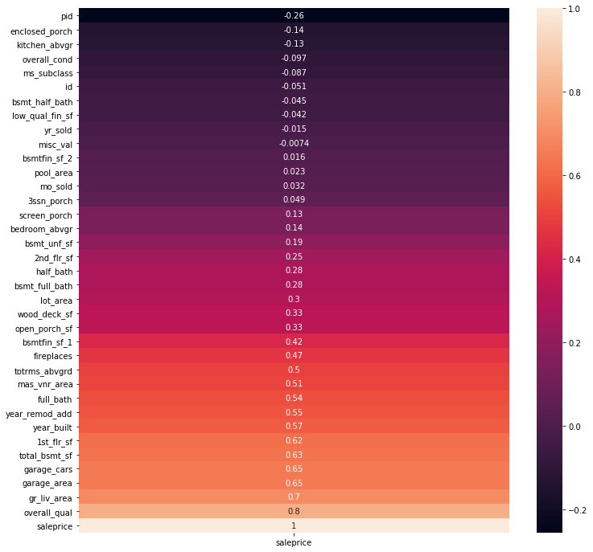
Heatmap:
Analysis between the
feature correlations
>= 0.50 to the sale price.

Slide 6
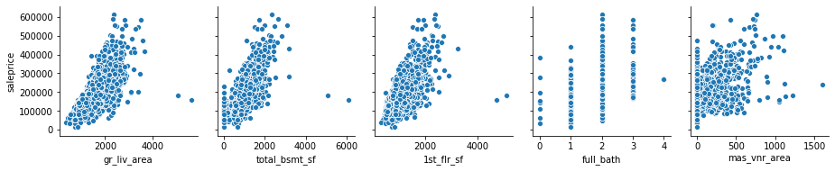
Outliers in features
Drop rows

Slide 7
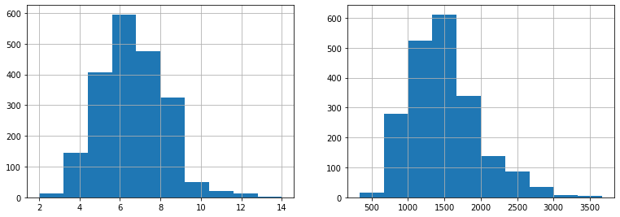
Feature engineering between total rooms & ground living area
Total rooms above grade & square feet

Slide 8
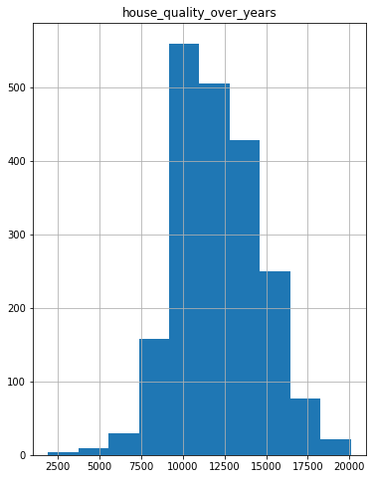
Feature engineering
Combined features:
Total rooms above grade & square feet

Slide 9
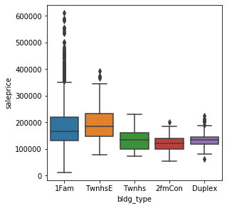
Qualitative features: Dummy selection
Boxplots
Building type
Land contour
Street
Central air

Slide 10
Pre-processing and modeling
1)Train, test and split
2)Standard scaler
3)R2 Scores
4)Applied OLS and Ridge regularization = same results
5) Cross validation: 0.88
Train | Test
0.87 | 0.88

Slide 11
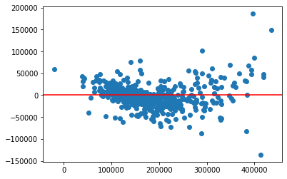
Residuals and predictions

Slide 12
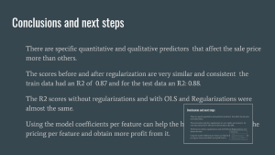
Conclusions and next steps
There are specific quantitative and qualitative predictors that affect the sale price more than others.
The scores before and after regularization are very similar and consistent the train data had an R2 of 0.87 and for the test data an R2: 0.88.
The R2 scores without regularizations and with OLS and Regularizations were almost the same.
Using the model coefficients per feature can help the house sellers to observe the pricing per feature and obtain more profit from it.

Slide 13
Using the model coefficients per feature can help the house buyers to observe the pricing per feature accoring to their dream home and budget.
Try different features, new features or removing features.
Try lasso regularization.

Slide 14
Thank you

